Slide 1
Dr. Ahmad Salman
DSP
Content and Figures are from Discrete-Time Signal Processing, 2e by Oppenheim, Shafer, and Buck, ©1999-2000 Prentice Hall Inc.

Slide 2
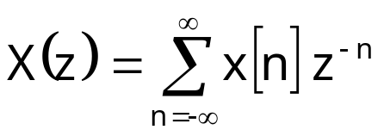
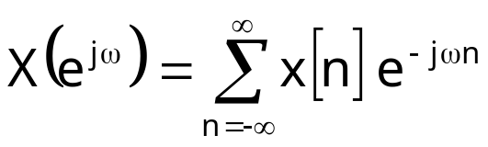
Chapter-3
The z-Transform
Counterpart of the Laplace transform for discrete-time signals
Generalization of the Fourier Transform
  Fourier Transform does not exist for all signals
The z-Transform is often time more convenient to use
Definition:
Compare to DTFT definition:
z is a complex variable that can be represented as z=r e^{jω}
Substituting z=e^{jω} will reduce the z-transform to DTFT

Slide 3

The z-transform and the DTFT
The z-transform is a function of the complex z variable
Convenient to describe on the complex z-plane
If we plot z=e^{jω} for ω=0 to 2π we get the unit circle
Im
Unit Circle
r=1
ω
0
Re
ω
2π
0
2π

Slide 4
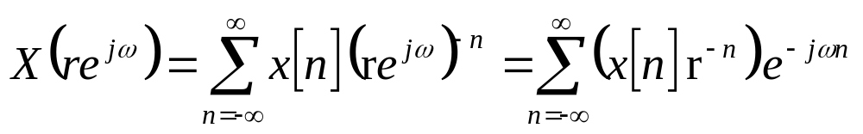
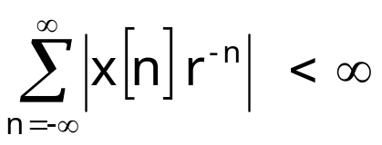
Convergence of the z-Transform
DTFT does not always converge
  Infinite sum not always finite if x[n] no absolute summable
  Example: x[n] = a^{n}u[n] for |a|>1 does not have a DTFT
Complex variable z can be written as r e^{jω} so the z-transform
DTFT of x[n] multiplied with exponential sequence r ^{-n}
  For certain choices of r the sum maybe made finite

Slide 5
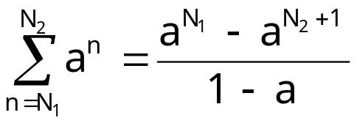
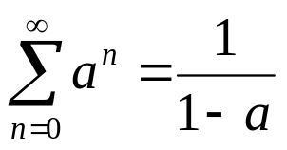
Convergence of the z-Transform
Rule of thumb:
  Try to apply either Finite Geometric Series or Infinite Geometric Series to the formula of z-transform.
  The condition on the series will tell you directly the Region where z-transform will converge.

Slide 6

Region of Convergence
The set of values of z for which the z-transform converges
Each value of r represents a circle of radius r
The region of convergence is made of circles
Example: z-transform converges for values of 0.5<r<2
  ROC is shown on the left
  In this example the ROC includes the unit circle, so DTFT exists
Not all sequence have a z-transform
Example:
  Does not converge for any r
  No ROC, No z-transform
  But DTFT exists?!
Im
Re

Slide 7
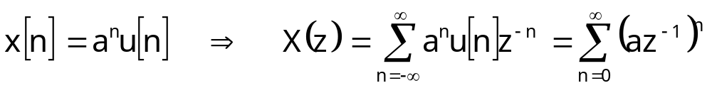
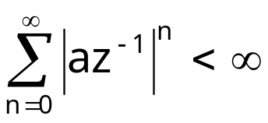
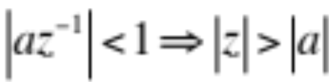
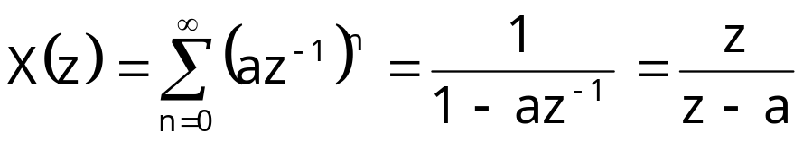
Right-Sided Exponential Sequence Example
For Convergence we require
Hence the ROC is defined as
In the ROC series converges to
Geometric series formula
Im
a
1
o
x
Re
Region outside the circle of radius a is the ROC
Right-sided sequence ROCs extend outside a circle

Slide 8
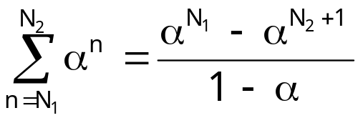
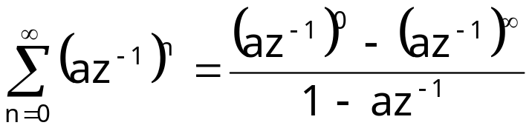
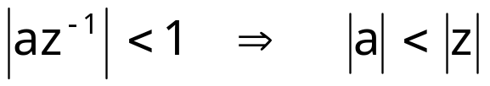
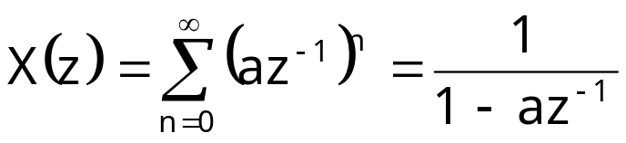
Same Example Alternative Way
For the term with infinite exponential to vanish we need
  Determines the ROC (same as the previous approach)
In the ROC the sum converges to

Slide 9
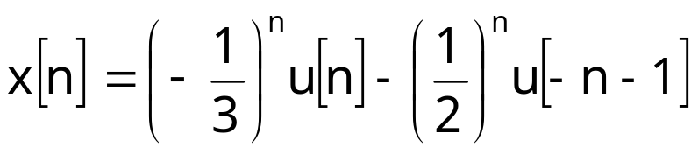
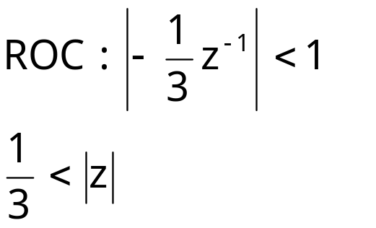
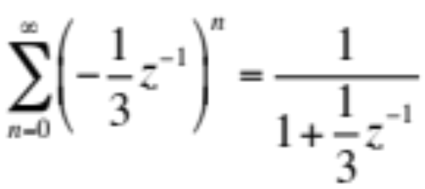
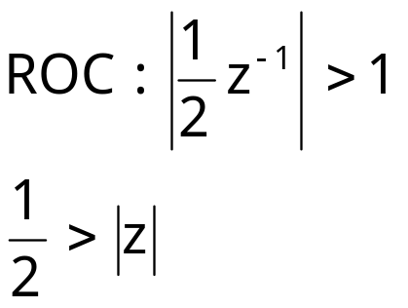
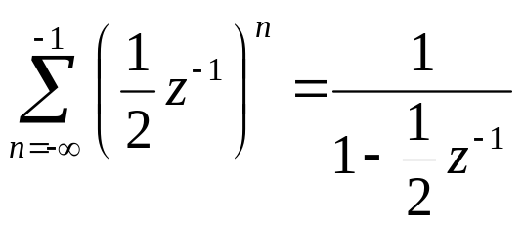
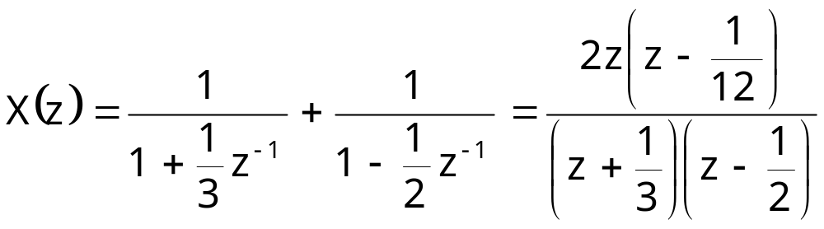



Two-Sided Exponential Sequence Example
Im
x
o
o
x
Re

Slide 10
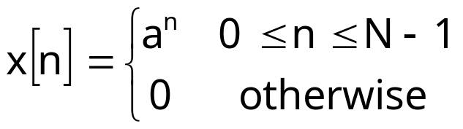
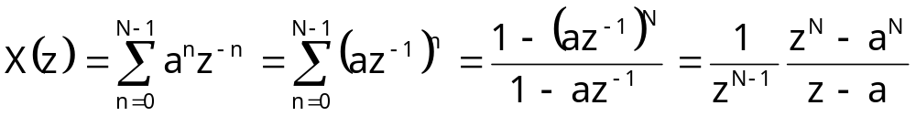
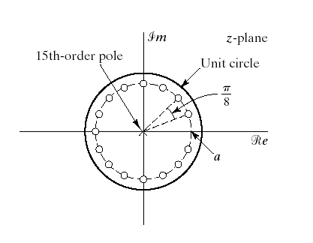
Finite Length Sequence

Slide 11
Properties of The ROC of Z-Transform
The ROC is a ring or disk centered at the origin
DTFT exists if and only if the ROC includes the unit circle
The ROC cannot contain any poles
The ROC for finite-length sequence is the entire z-plane
  except possibly z=0 and z=∞
The ROC for a right-handed sequence extends outward from the outermost pole possibly including z= ∞
The ROC for a left-handed sequence extends inward from the innermost pole possibly including z=0
The ROC of a two-sided sequence is a ring bounded by poles
The ROC must be a connected region
A z-transform does not uniquely determine a sequence without specifying the ROC

Slide 12
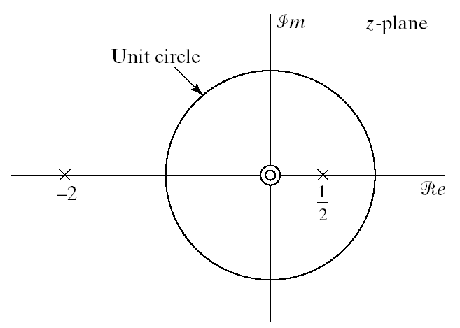
Stability, Causality, and the ROC
Consider a system with impulse response h[n]
The z-transform H(z) and the pole-zero plot shown below
Without any other information h[n] is not uniquely determined
  |z|>2 or |z|<½ or ½<|z|<2
If system stable ROC must include unit-circle: ½<|z|<2
If system is causal must be right sided: |z|>2

Slide 13
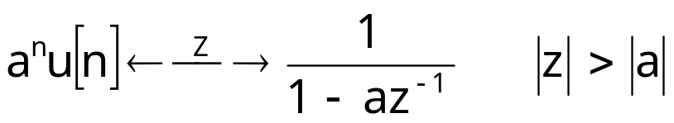
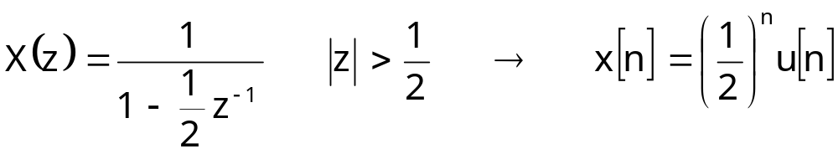
The Inverse Z-Transform
Formal inverse z-transform is based on a Cauchy integral
Less formal ways sufficient most of the time
  Inspection method
  Partial fraction expansion
  Power series expansion
Inspection Method
  Make use of known z-transform pairs such as
  Example: The inverse z-transform of

Slide 14
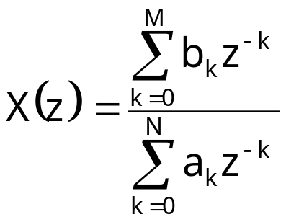
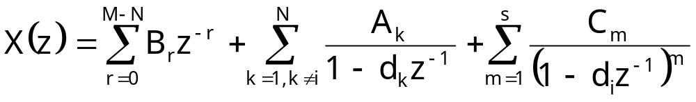
Inverse Z-Transform by Partial Fraction Expansion
Assume that a given z-transform can be expressed as
Apply partial fractional expansion
First term exist only if M>N
  B_{r} is obtained by long division
Second term represents all first order poles
Third term represents an order s pole
  There will be a similar term for every high-order pole
Each term can be inverse transformed by inspection

Slide 15
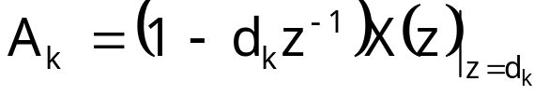
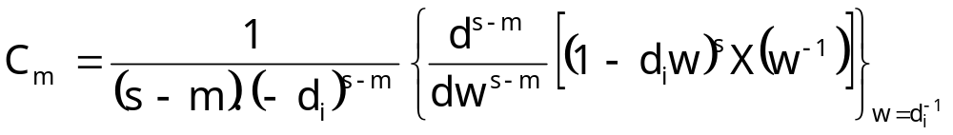
Partial Fractional Expression
Coefficients are given as
Easier to understand with examples

Slide 16
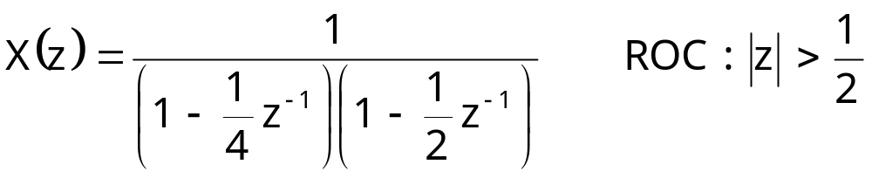
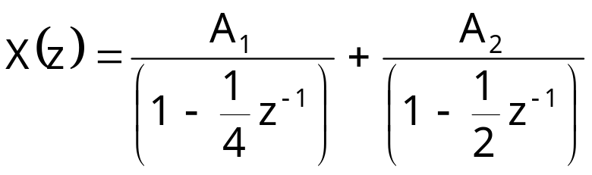
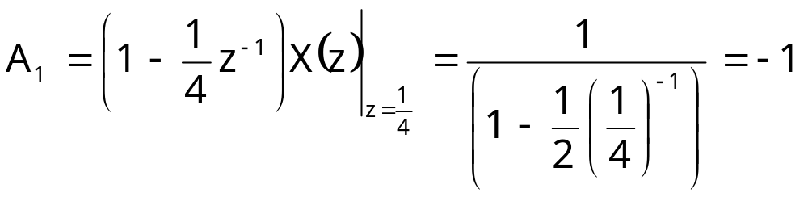
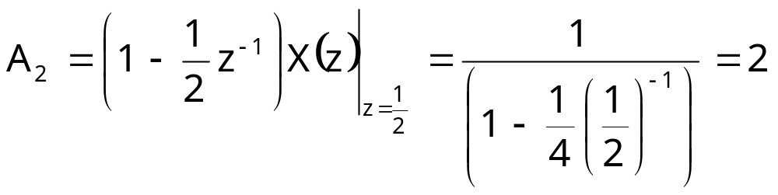
Example: 2nd Order Z-Transform
  Order of nominator is smaller than denominator (in terms of z⁻¹)
  No higher order pole

Slide 17
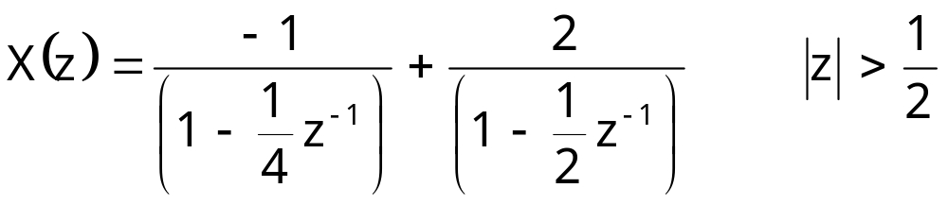
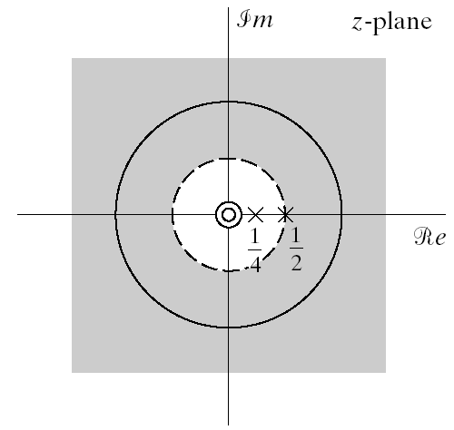
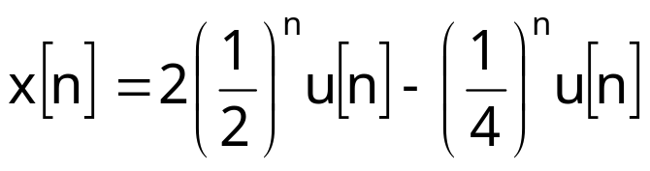
Example Continued
ROC extends to infinity
  Indicates right sided sequence

Slide 18
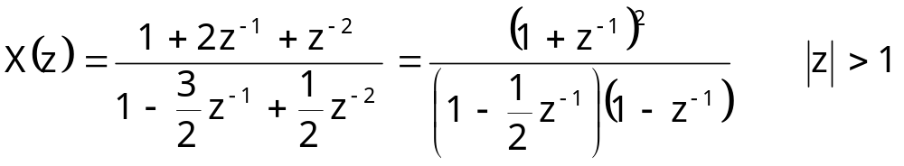
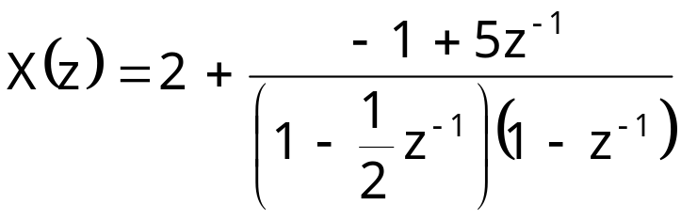
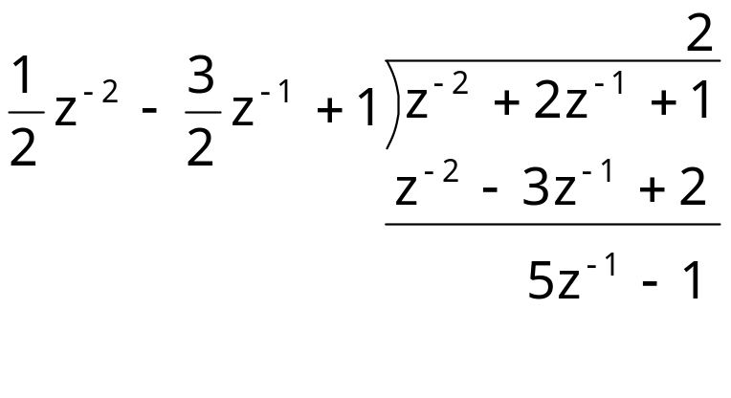
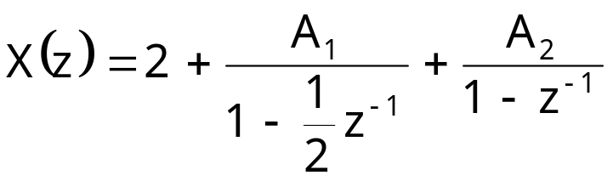
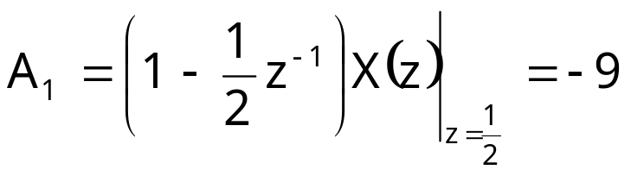
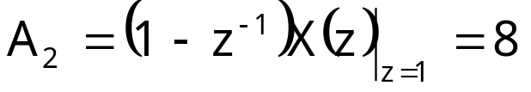
Example #2
Long division to obtain

Slide 19
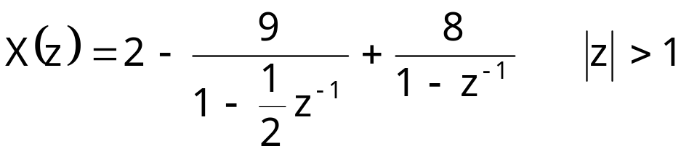
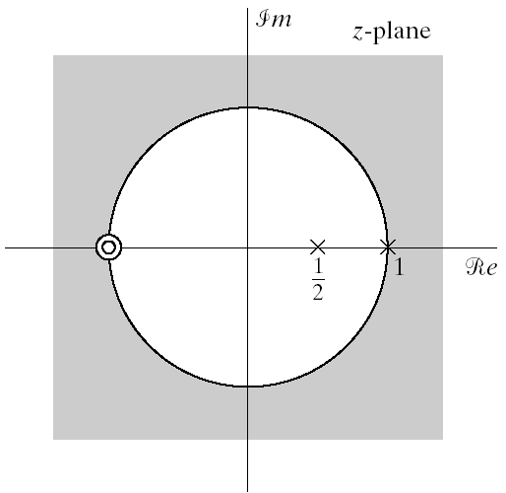
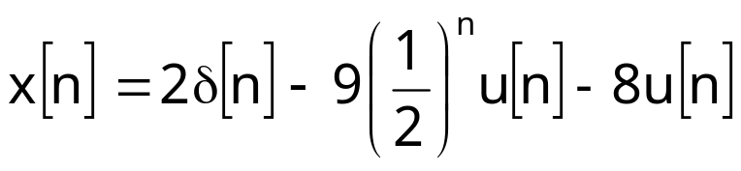
Example #2 Continued
ROC extends to infinity
  Indicates right-sides sequence

Slide 20
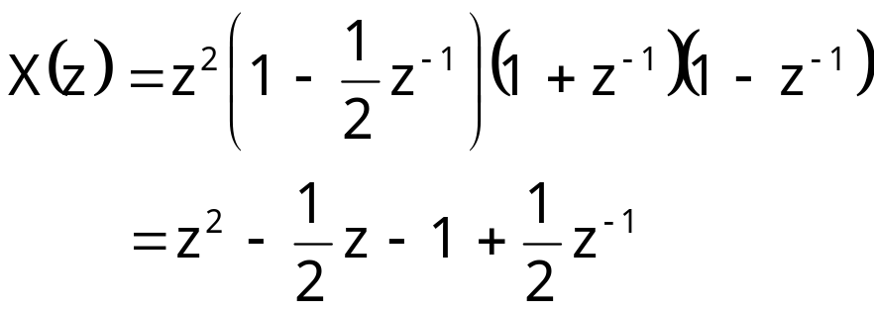
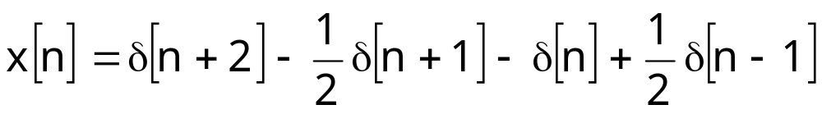
Inverse Z-Transform by Power Series Expansion
The z-transform is power series
In expanded form
Z-transforms of this form can generally be inversed easily
Especially useful for finite-length series
Example

Slide 21

Z-Transform Properties: Linearity
Notation
Linearity
  Note that the ROC of combined sequence may be larger than either ROC
  This would happen if some pole/zero cancellation occurs
  Example:
    Both sequences are right-sided
    Both sequences have a pole z=a
    Both have a ROC defined as |z|>|a|
    In the combined sequence the pole at z=a cancels with a zero at z=a
    The combined ROC is the entire z plane except z=0
We did make use of this property already, where?

Slide 22
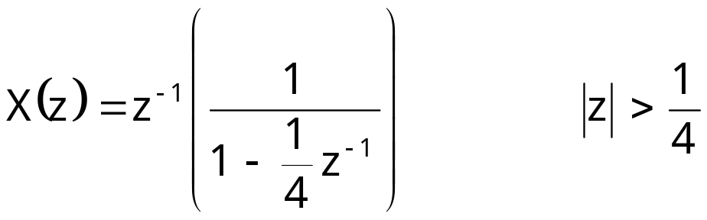
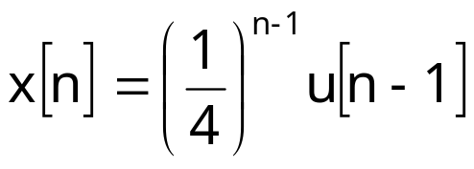
Z-Transform Properties: Time Shifting
Here n_{o} is an integer
  If positive the sequence is shifted right
  If negative the sequence is shifted left
The ROC can change the new term may
  Add or remove poles at z=0 or z=∞
Example

Slide 23



Z-Transform Properties: Multiplication by Exponential
ROC is scaled by |z_{o}|
All pole/zero locations are scaled
If z_{o} is a positive real number: z-plane shrinks or expands
If z_{o} is a complex number with unit magnitude it rotates
Example: We know the z-transform pair
Let’s find the z-transform of

Slide 24

Z-Transform Properties: Conjugation
Example

Slide 25




Z-Transform Properties: Time Reversal
ROC is inverted
Example:
Time reversed version of

Slide 26






Z-Transform Properties: Convolution
Convolution in time domain is multiplication in z-domain
Example:Let’s calculate the convolution of
Multiplications of z-transforms is
ROC: if |a|<1 ROC is |z|>1 if |a|>1 ROC is |z|>|a|
Partial fractional expansion of Y(z)

Slide 27





Z-Transform Properties: Differentiation
Example: We want the inverse z-transform of
Let’s differentiate to obtain rational expression
Making use of z-transform properties and ROC

